Slide 1
Optical Flow
MVP Seminar
2017.07.21

Slide 2
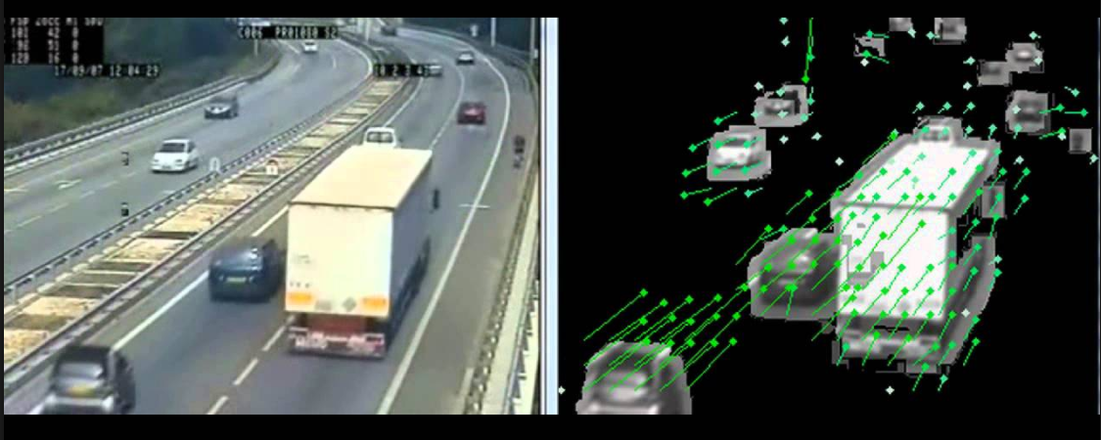
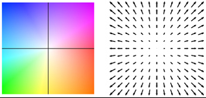
Optical Flow
Goal : Pixel motion from frame1 to frame2

Slide 3
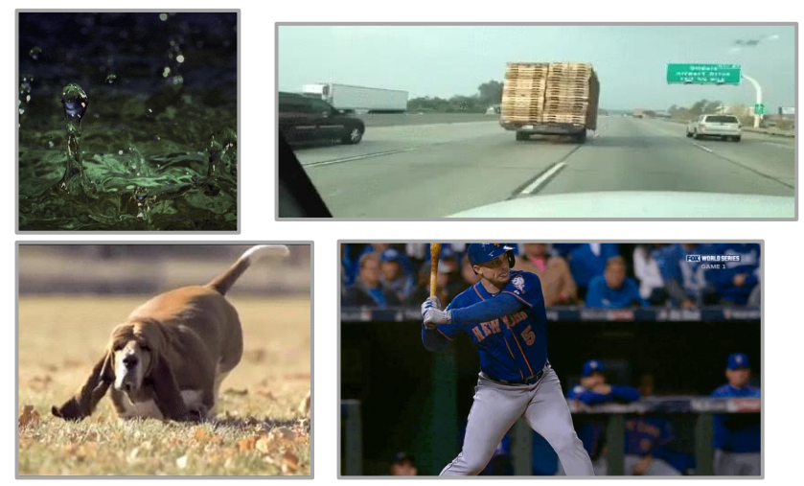
Why Optical Flow is important?
We live in a moving world

Slide 4
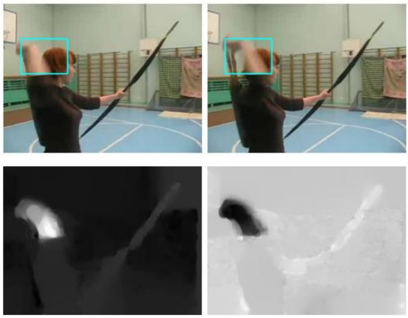
Why Optical Flow is important?
Recognize actions in video

Slide 5
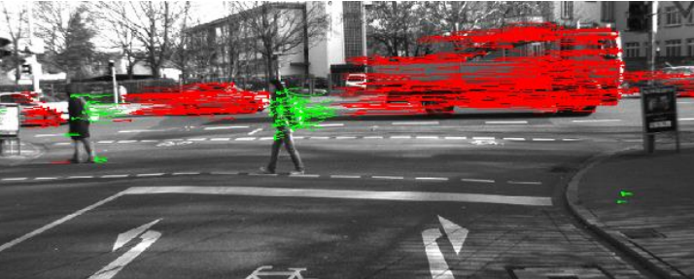
Why Optical Flow is important?
Tracking motion of objects

Slide 6
Why Optical Flow is important?
Tracking motion of objects

Slide 7
Why Optical Flow is Difficult?
Scale change
Large Displacement
illumination change
Occsions
Repetitive structure
Small object

Slide 8
Optical Flow
Handcraft Algorithm

Slide 9
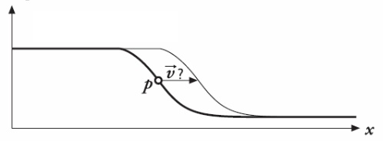
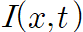
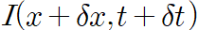
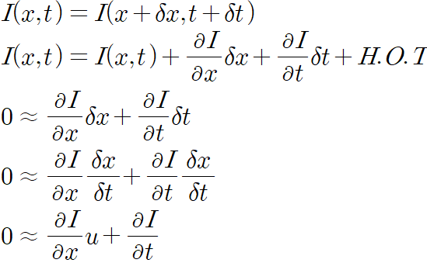
Optical Flow
Optical Flow in 1D
Optical Flow !

Slide 10
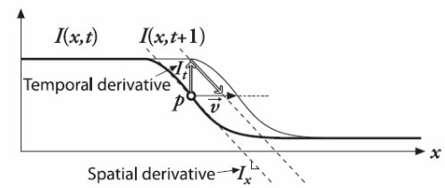
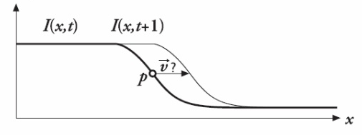
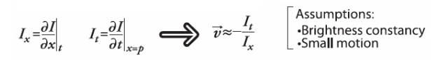
Optical Flow
Optical Flow in 1D

Slide 11
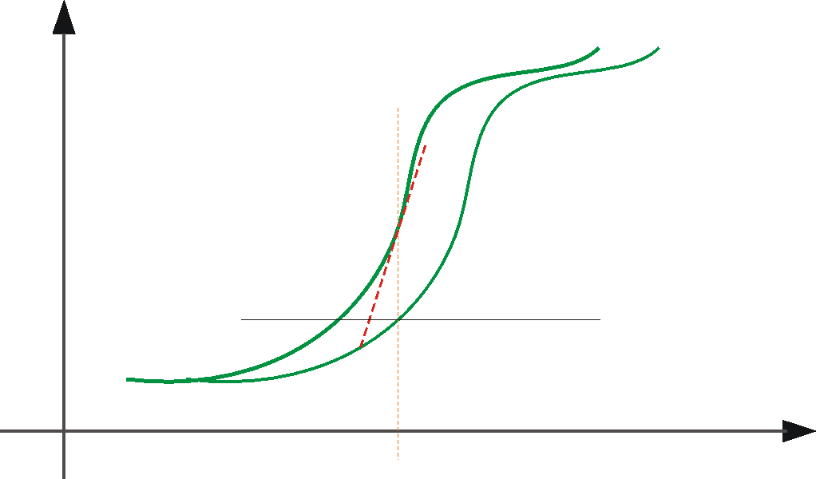
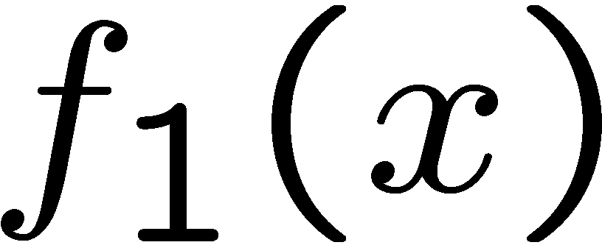
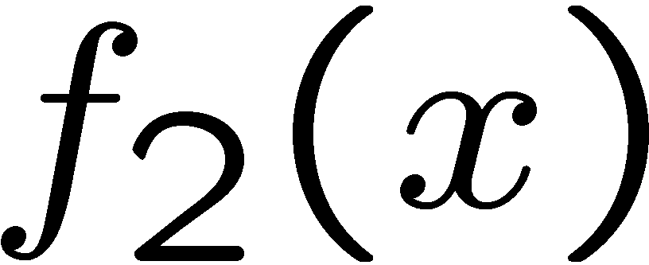

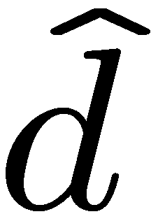
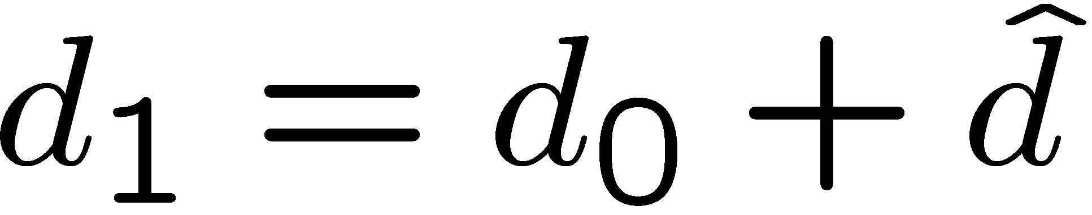
Optical Flow
Optical Flow in 1D
estimate update
Initial guess:
Estimate:
x₀
x
(using d for displacement here instead of u)

Slide 12
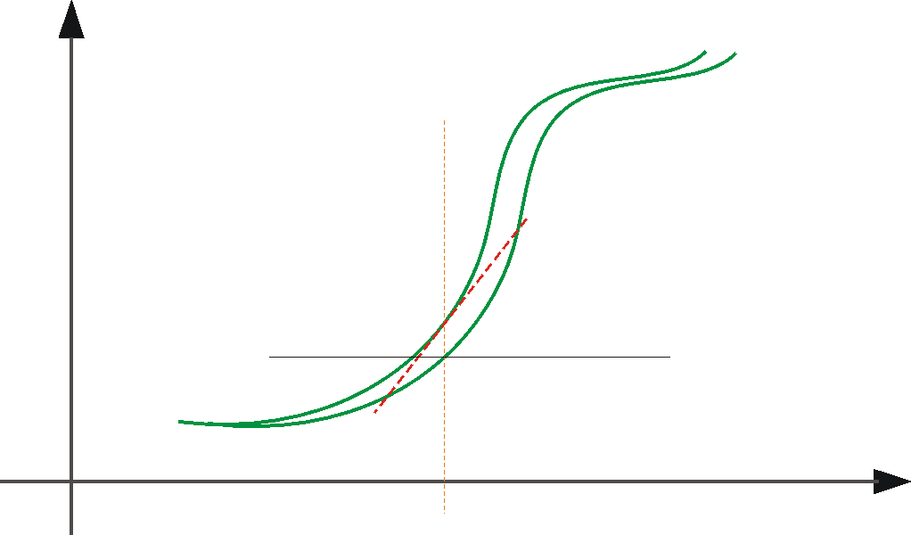
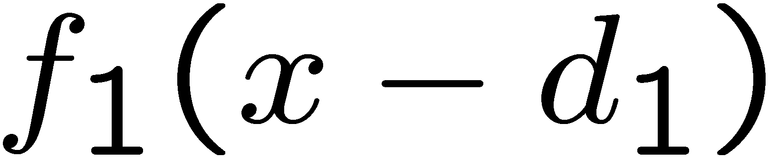
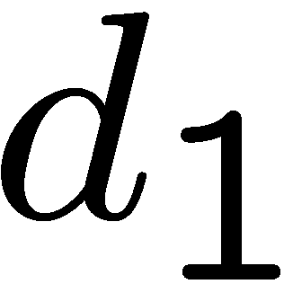
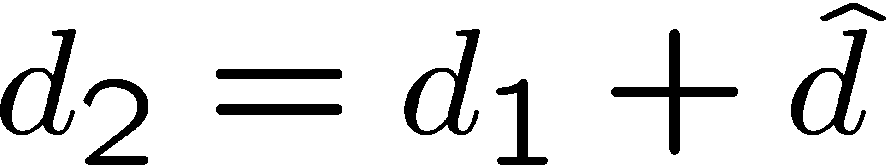
Optical Flow
Optical Flow in 1D
estimate update
Initial guess:
Estimate:
x₀
x

Slide 13
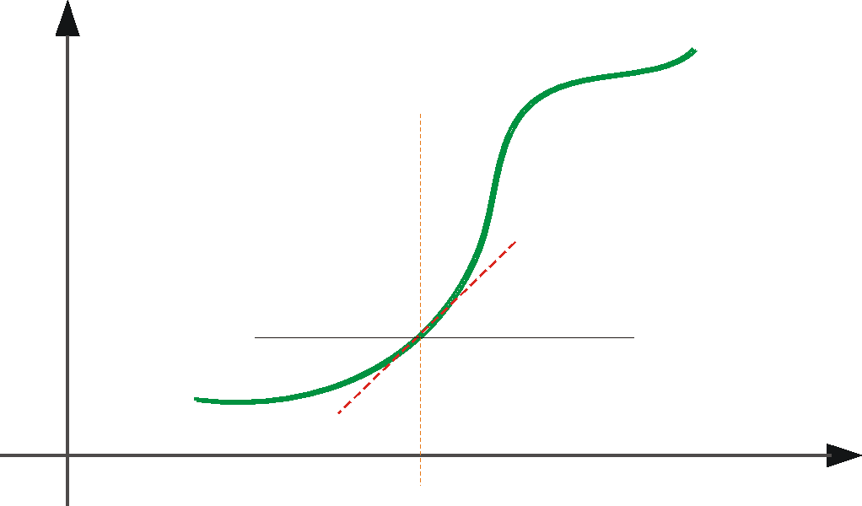
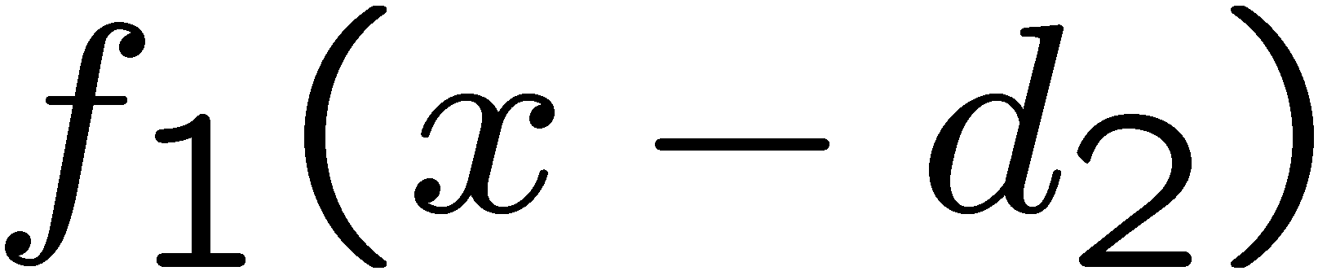
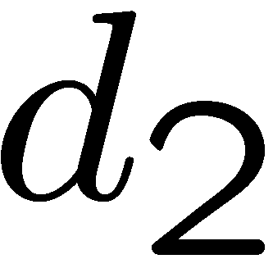
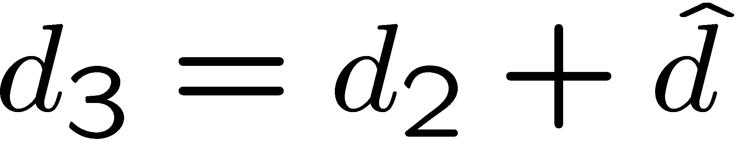
Optical Flow
Optical Flow in 1D
estimate update
Initial guess:
Estimate:
Initial guess:
Estimate:
x₀
x

Slide 14
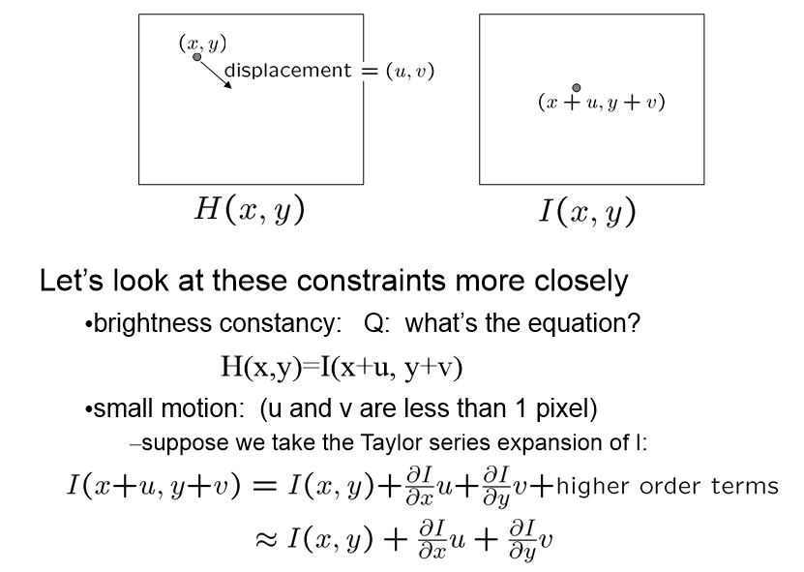
Optical Flow
Optical Flow in 2D

Slide 15
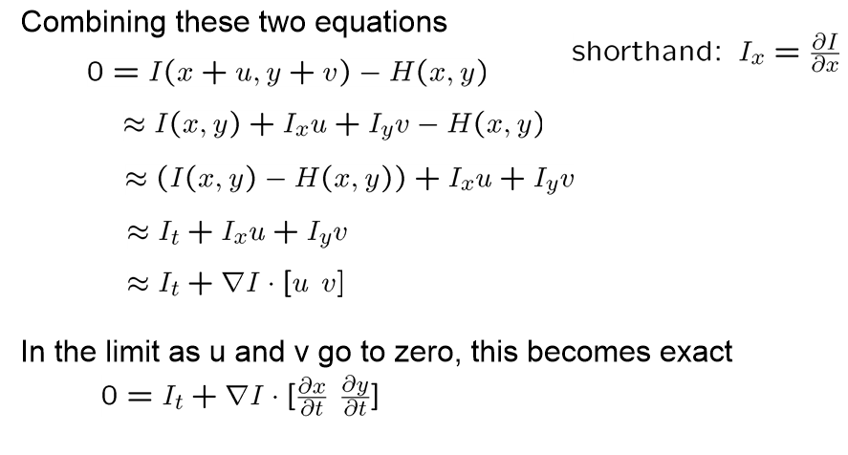
Optical Flow
Optical Flow in 2D

Slide 16
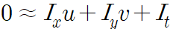
Optical Flow
Optical Flow in 2D
1 equation, 2 unknows ??

Slide 17
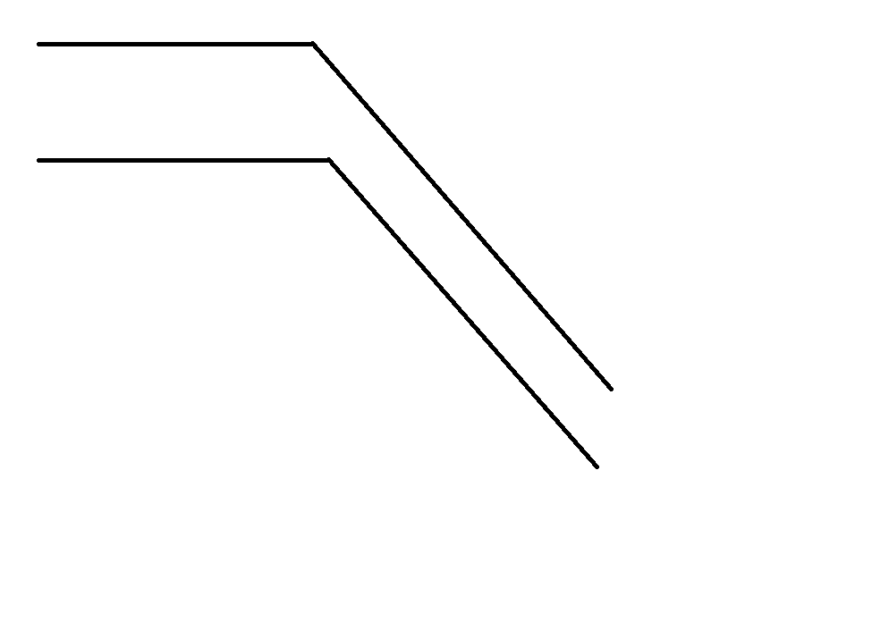
Optical Flow
Optical Flow in 2D
- Aperture Problem
1 Pixel

Slide 18
Optical Flow
Optical Flow in 2D
- Aperture Problem
1 Pixel

Slide 19
Optical Flow
Optical Flow in 2D
- Aperture Problem

Slide 20
Optical Flow
Optical Flow in 2D
- Aperture Problem

Slide 21
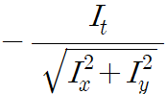
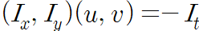
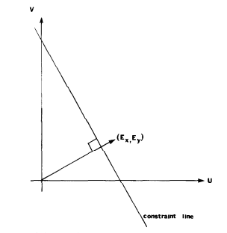
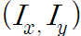
Optical Flow
Optical Flow in 2D
1 equation, 2 unknows ??
1 pixel
gradient direction
Contour direction??

Slide 22
Optical Flow
Optical Flow in 2D
- Aperture Problem
1 Pixel

Slide 23
Optical Flow
Optical Flow in 2D
- Aperture Problem
1 Pixel

Slide 24
Optical Flow
Optical Flow in 2D
- Aperture Problem

Slide 25
Optical Flow
Optical Flow in 2D
- Aperture Problem

Slide 26
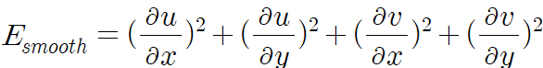
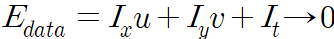
Optical Flow
Optical Flow in 2D
energy minimization [Horn and schunck 1981]
one more constraint !
=>neighboring points on the objects have similar velocities
=>the velocity field of the brightness patterns varies smoothly

Slide 27
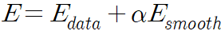
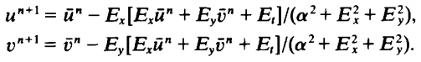
Optical Flow
Optical Flow in 2D
energy minimization [Horn and schunck 1981]
color/gradient constancy
smoothness constraint
find u,v to minimize E (total error)
Iterative Solution
수렴이 잘 안되어 단독으로 쓰기는 어렵고 다른방법과 같이 쓴다.!!
초기값이 중요

Slide 28
Optical Flow
Optical Flow in 2D
1 equation, 2 unknows ??

Slide 29
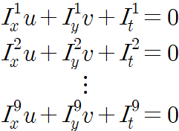
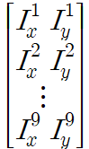
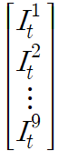
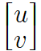
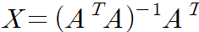
Optical Flow
Optical Flow in 2D
Lukas Kanade Method [Lucas and Kanade 1981]
I1 | I2 | I3
I4 | I5 | I6
I7 | I8 | I9
sliding window
pseudo inverse
=> least mean square

Slide 30
Optical Flow
Optical Flow
- Lucas Kanade method
- energy minimization
=> 아주 작은 움직임에만 동작 큰 움직임에는 쓸 수 없는 수준!
sliding window

Slide 31
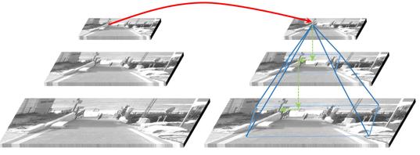
Optical Flow
Optical Flow
큰 움직임 문제를 해결하기 위해 ! => coarse to fine scheme!

Slide 32
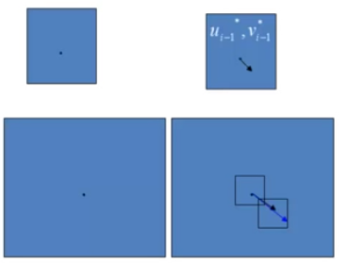
Optical Flow
Optical Flow
큰 움직임 문제를 해결하기 위해 ! => coarse to fine scheme!

Slide 33
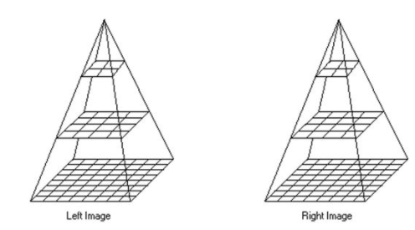
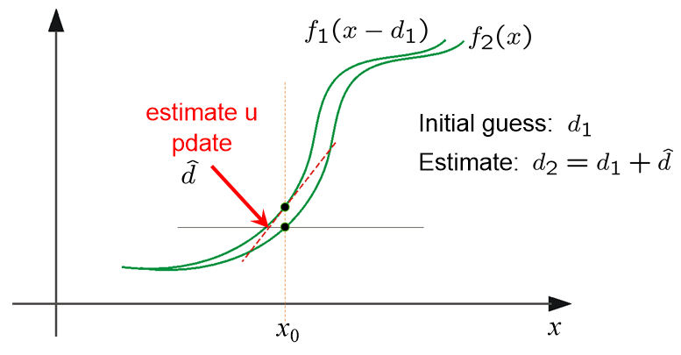
Optical Flow
Optical Flow
큰 움직임 문제를 해결하기 위해 ! => coarse to fine scheme!
1. estimate flow
-energy minimization
-lucas kanade
2. warping frame2 with flow
3. repeat 1,2
4. interpolation

Slide 34
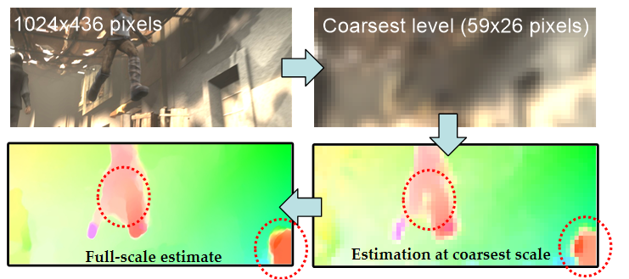
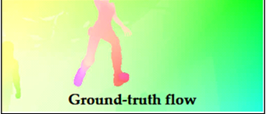
Optical Flow
Optical Flow
coarse to fine pyramid scheme
=> coarse 의 error가 fine으로 전파되는 경향이 있음
=> coarsest 의 error는 fine으로 갈수록 증대 된다. (치명적)

Slide 35
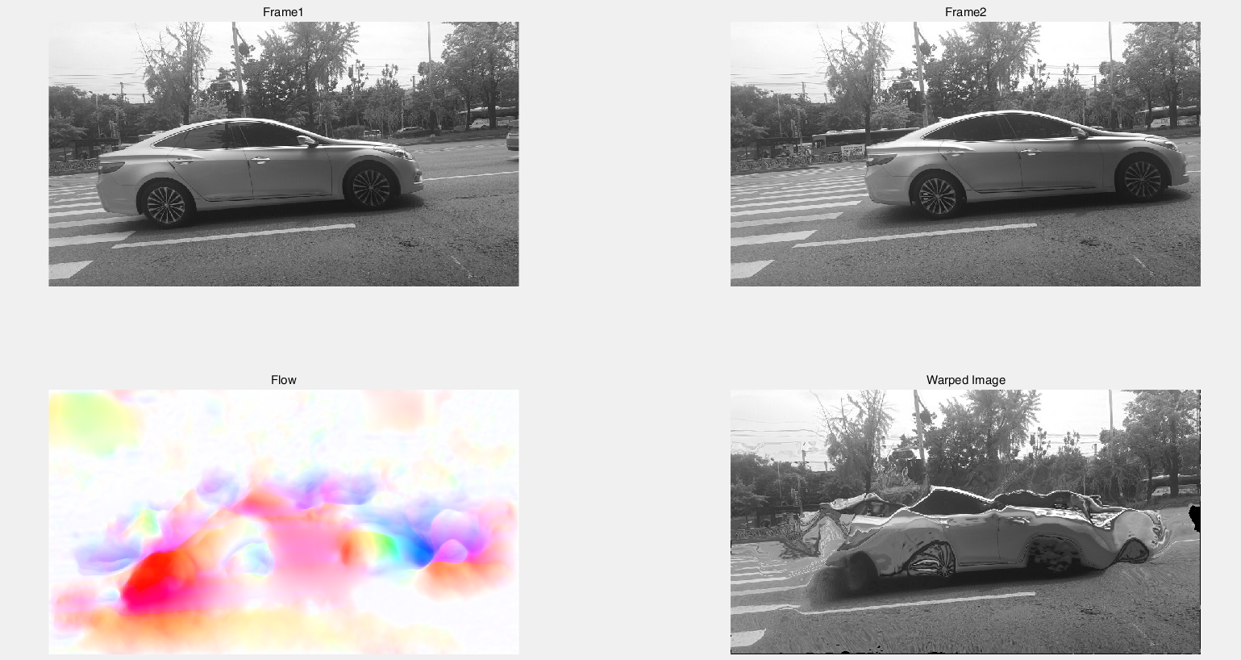
Optical Flow
Optical Flow
coarse to fine pyramid scheme
=> coarse 의 error가 fine으로 전파되는 경향이 있음
=> coarsest 의 error는 fine으로 갈수록 증대 된다. (치명적)

Slide 36
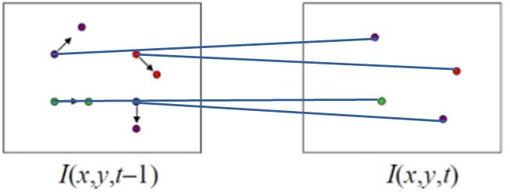
Optical Flow
Optical Flow
큰 움직임을 위한 optical flow
Brightness constancy 는 너무 사정거리가 짧다!
색깔만으로 같은 부분을 구별하기는 힘들다.
Brightness constancy
large에 강인함
Descriptor Matching

Slide 37

Optical Flow
Optical Flow
큰 움직임을 위한 optical flow
Large Displacement Optical Flow (LDOF) [T Brox and J Malik 2011]
Descriptor Matching
=> HOG, SIFT, DAISY, Census
energy minimization
초기값

Slide 38
Optical Flow
Optical Flow
큰 움직임을 위한 optical flow
Large Displacement Optical Flow (LDOF) [T Brox and J Malik 2011]
Descriptor Matching
HOG, SIFT, DAISY, Census => Too much sparse for optical flow

Slide 39


Optical Flow
Optical Flow
큰 움직임을 위한 optical flow
Deep Matching [P. Weinzaepfel, j. Revaud 2013] => Dense하게 matching이 가능함
=> 반복적 무늬에 대해서도 강인함

Slide 40
Optical Flow
Optical Flow
큰 움직임을 위한 optical flow
Deep Flow [P. Weinzaepfel, j. Revaud 2013]
Descriptor Matching
=> Deep Matching
energy minimization
초기값

Slide 41

Optical Flow
Optical Flow
state of the art optical flow
Epic Flow : Edge-Preserving Interpolation of Correspondences for Optical Flow
Deep Matching

Slide 42
Optical Flow
Optical Flow
state of the art optical flow
Epic Flow : Edge-Preserving Interpolation of Correspondences for Optical Flow
Interpolation using Euclidean distance

Slide 43

Optical Flow
Optical Flow
state of the art optical flow
Epic Flow : Edge-Preserving Interpolation of Correspondences for Optical Flow
Edge aware distance : Geodesic Distance
edge
Geodesic
edge
far
close
Euclidean

Slide 44

Optical Flow
Optical Flow
Epic Flow
energy minimization
초기값

Slide 45


Optical Flow
Result
Dense

Slide 46
Optical Flow
Overview
장점 : 학습을 시킬 필요가 없다. (optical flow는 데이터가 많이 부족)
단점 : 시간이 너무 오래걸린다. (epic flow 대략 32s)
color matching
descriptor matching
SIFT, DAISY, Deep matching
energy minimization
coarse to fine
처음 부터 쓸 수 없고 초기값의 정확성이 보장된 상태에서 refinement의 목적으로 사용한다.

Slide 47
Thank you
Q&A

